Slide 1
Column-Stores vs. Row-Stores How Different are they Really?
Daniel J. Abadi, Samuel Madden and Nabil Hachem, SIGMOD 2008
Presented by: Mehvish Saleem

Slide 2
Contents
Structural difference between column and row store
Contributions
Emulation of column-store in row store
Column-oriented optimizations esp. Invisible join
Column-store performance contributors
Experiments and Results
Conclusion

Slide 3
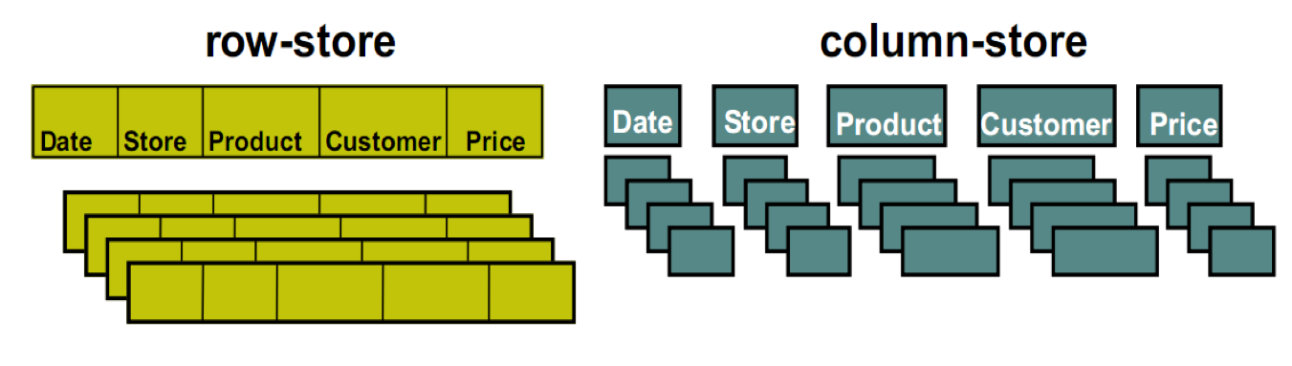
What is Column-Store?
Row-store stores data in the disk tuple by tuple
Column-store stores data in the disk column by column

Slide 4
Emulation of column-store in row-store
Vertical partitioning
Using index-only plans
Using materialized views

Slide 5
Vertical Partitioning
Full Vertical partitioning of each relation
Each column = 1 Physical table
Can be achieved by adding integer position column to every table
Join on position for multi-column fetch
Problems:
“Position” - Space and disk bandwidth
Header for every tuple – further space wastage

Slide 6
Index-only plans
Add B+Tree index for every Table column
Plans never access the actual tuples on disk
Headers are not stored, so per tuple overhead is less
Problems:
Separate indices may require full index scan, which is slower
E.g.: SELECT AVG(salary) FROM emp WHERE age > 40

Slide 7
Materialized Views
Create ‘optimal' set of MVs for given query workload
Objective:
Provide just the required data
Avoid overheads
Performs better
Expected to perform better than other two approach
Problems:
Require knowledge of query workloads in advance

Slide 8
Column-oriented execution
Compression
Late Materialization
Block Iteration
Invisible join

Slide 9
Compression
Perform better on data with low information entropy
Column-store data super compressible
Improves performance
Less space
Less time spent in I/O

Slide 10
Late Materialization
Delay Tuple Construction
Might avoid constructing it altogether
Eg: SELECT R.a FROM R WHERE R.c = 5 AND R.b = 10
Output of each predicate is a bit string
Perform Bitwise AND
Use final position list to extract R.a

Slide 11
Block Iteration
Iterate over blocks of tuples rather than tuple-at-a-time
Like batch processing
If column is fixed width, it can be operated as an array
Exploits potential for parallelism

Slide 12
Invisible Join

Slide 13
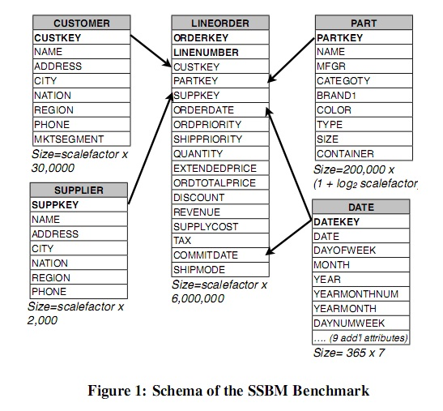
Star Schema Benchmark

Slide 14
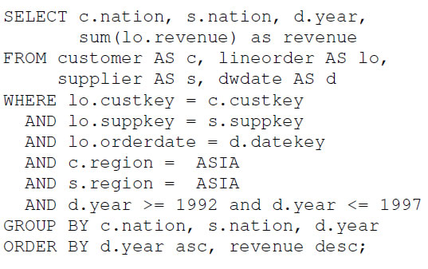
Sample Query
Find total revenue from Asian customers who purchase a product supplied by an Asian supplier between 1992 and 1997 grouped by nation of the customer, supplier and year of transaction

Slide 15
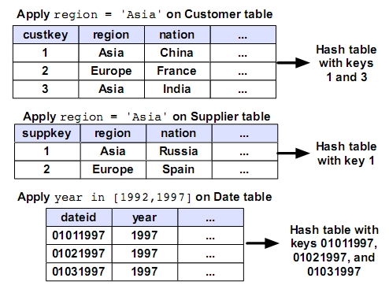
Phase I

Slide 16
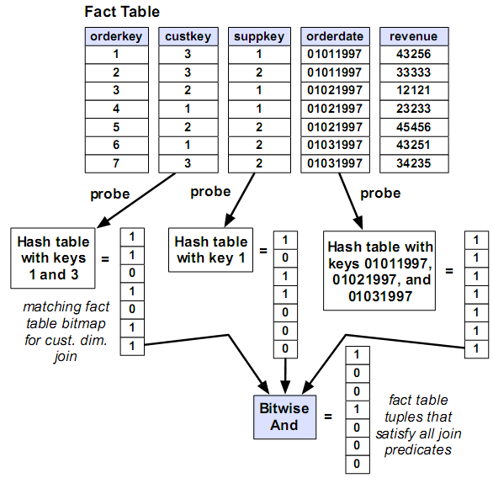
Phase II

Slide 17
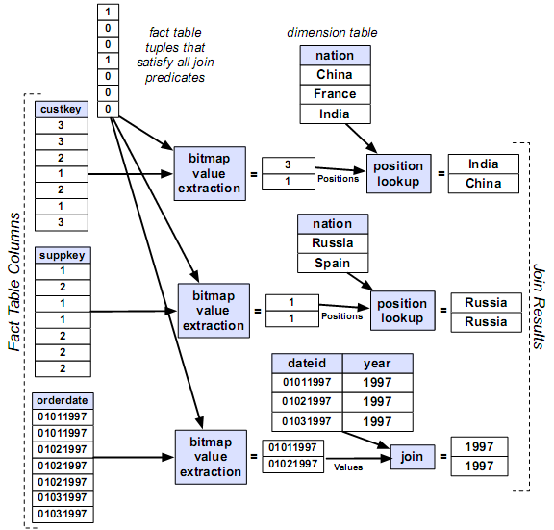
Phase III

Slide 18
Experiments

Slide 19
Purpose
Comparing the performance of C-Store with column-store emulation in row-store
Most significant optimization for column-stores
Can unmodified row store obtain benefits of column-store?

Slide 20
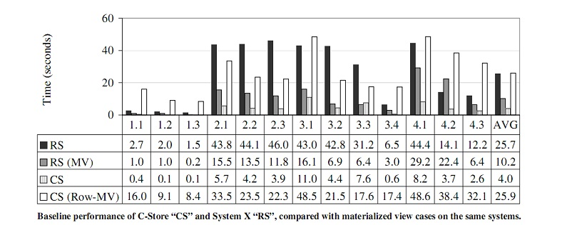
C-Store VS System X
RS: Base System X
CS: Base C-Store
RS (MV): System X with optimal collection of MVs
CS (Row-MV): Column store constructed from RS(MV)

Slide 21
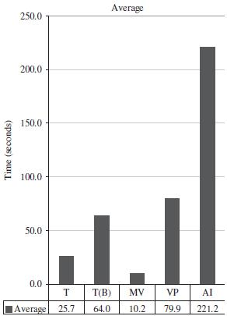
Different System X Configurations
T: Traditional
T(B): Traditional Bitmap
MV: Materialized View
VP: Vertical Partitioning
AI: All Indexes

Slide 22
Results and Analysis
MV performs best since they read minimal amount of data needed by a query
Index only plans are the worst:
Expensive column joins on fact table
Vertical partitioning:
Tuple overheads and reconstruction
Column Store perform better than the best case of row store (4.0 sec VS 10.2 sec)

Slide 23
Conclusion
Emulation of a column-store in a row-store does not yield good results
Tuple reconstruction costs
A pain to implement
Most important optimizations for column-store: Compression and Late Materialization

Slide 24
Thank you!

